Slide 1
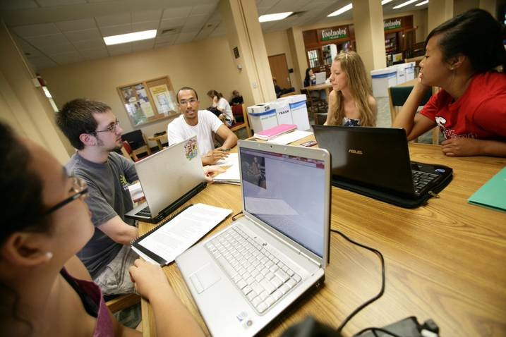

Academic Achievement Programs
Academic Success and Tutorial Services
FREE Tutoring in Spring 2015!
  BMGT 220
  BMGT 230
  BMGT 310
  BMGT 340
  BSCI 105
  BSCI 106
  BSCI 201
  BSCI 202
  BSCI 207
  BSCI 222
  BSCI 330
  CHEM 131
  CHEM 135
  CHEM 136
  CHEM 231
  CHEM 241
  CHEM 271
  CMSC 131
  CMSC 132
  CMSC 216
  CMSC 250
  ECON 200
  ECON 201
  ECON 300
  ECON 321
  ECON 330
  MATH 113
  MATH 130
  MATH 140
  MATH 141
  MATH 206
  MATH 220
  MATH 246
  PHIL 100
  PHIL 170
  PSYC 200
  PSYC 221
  STAT 100
  STAT 410
See contact information below to reserve your spot!
Contact: Christine Duchouquette
Email: cduchou@umd.edu or
Call: 301-405-4745 or
Visit: Marie Mount Hall 2204B

